Slide 1
Bank Telemarketing Analysis
404 Brain Not Found
Notes:
Hello everyone, We are 404 Brain Not Found, today we will take all of you back to 2010, when we take a case from a bank of Portugal.

Slide 2
Scenario
We work for a Portugal Bank. The past few telemarketing campaigns have not gone as well as the firm would have hoped, and they are looking for ways to optimize their marketing efforts. They have supplied you with data from a previous campaign and some additional metrics such as the consumer price index and consumer confidence index. They want to know whether you can predict the likelihood of subscribing to a term deposit. The manager would also like to know what factors are most likely to increase a customer's probability of subscribing.
Notes:
We are asked by the bank manager to assess the effectiveness of the telemarketing campaign based on sales data in the past 3 years from 2008 to 2010, and figure out what factors can be used for improving future campaigns.

Slide 3
Data Cleaning and Preprocessing
Missing Value Handling & Dimension Reduction & Scaling
1
Models for Explaining and Prediction
Logistic Regression & Random Forests
2
Model Enhancement
SMOTE, SVM, K-means Clustering
3
Economic Analysis
Macroeconomics Interpretation
4
Project Timeline
Notes:
As we receive the data, we can use it to build predictive models and furnish it so that we can fulfill the bank's goal of predicting probability. From the models as well as the learning procedure, we are expected to gain some insights regarding this business.

Slide 4
Data Cleaning And Preprocessing
Part 1

Slide 5
Data Preprocessing
Data Preprocessing
Model Building
Model Enhancement
Economic Analysis
Dropped “pdays” : too many unknown values
Dropped “duration”: highly affects the output target (e.g., if duration=0 then y='no'). Yet, the duration is not known before a call is performed
Add “Year” column: would like to trace effects of financial crisis
Impute missing values with distribution of the known data
Notes:
Among the 21 independent variables provided, we first dropped irrelevant columns with missing data. We add a year column as our data was just around the 2008 financial crisis, and we would like to trace the timeline.

Slide 6
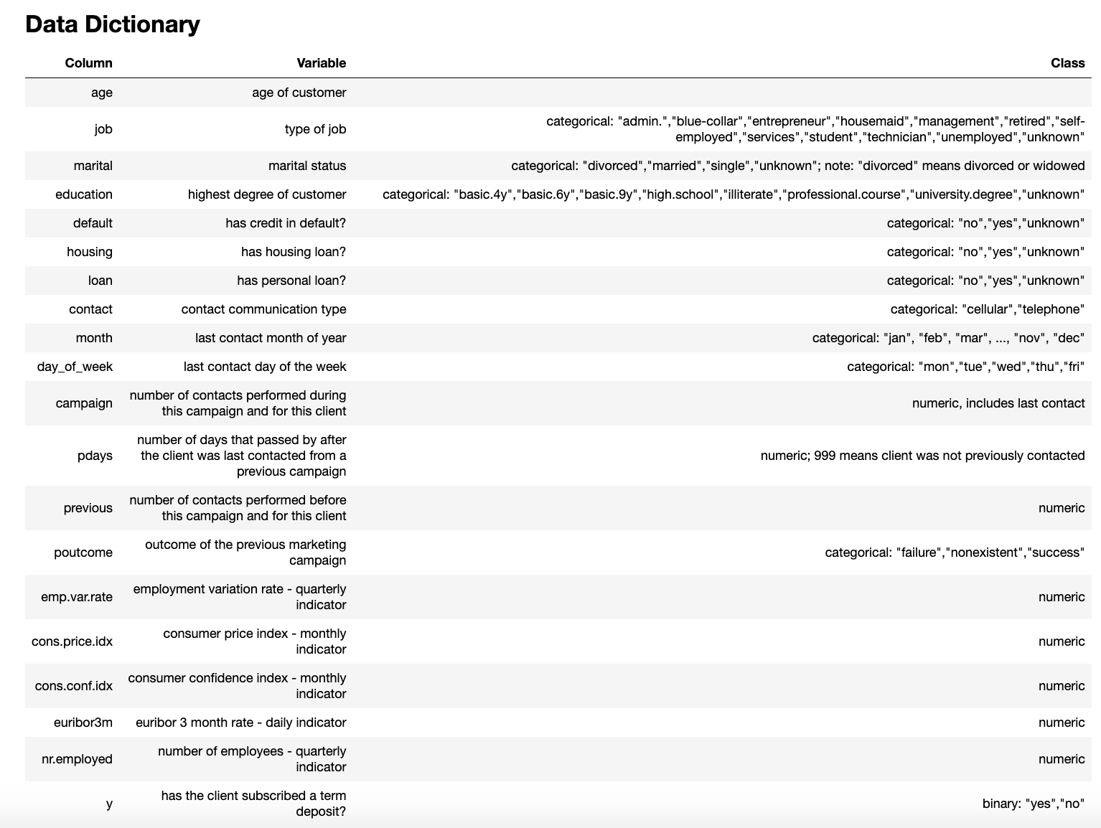
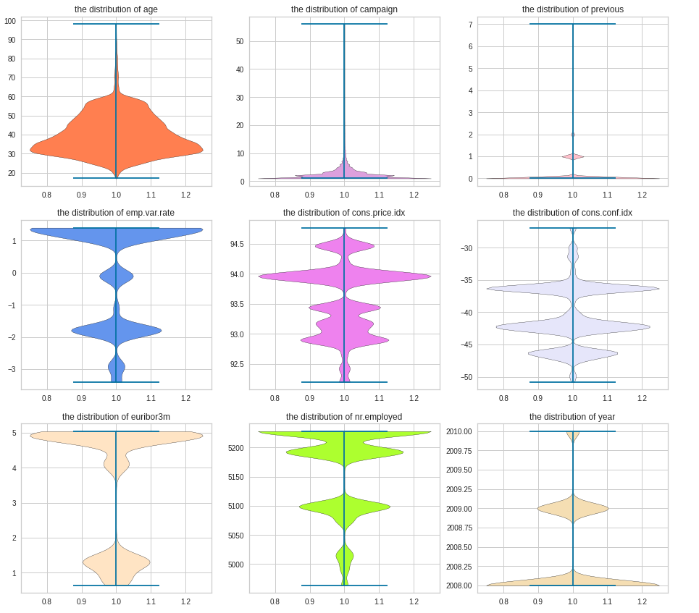
Data Preprocessing
Model Building
Model Enhancement
Economic Analysis
19 Independent Variables
Data Overview - Continuous Variables
Notes:
Here’s the dictionary of our data after preprocessing. Here’s a quick look for continuous and discrete variables’ distributions. For large-ranged continuous variables, we standardized them.

Slide 7
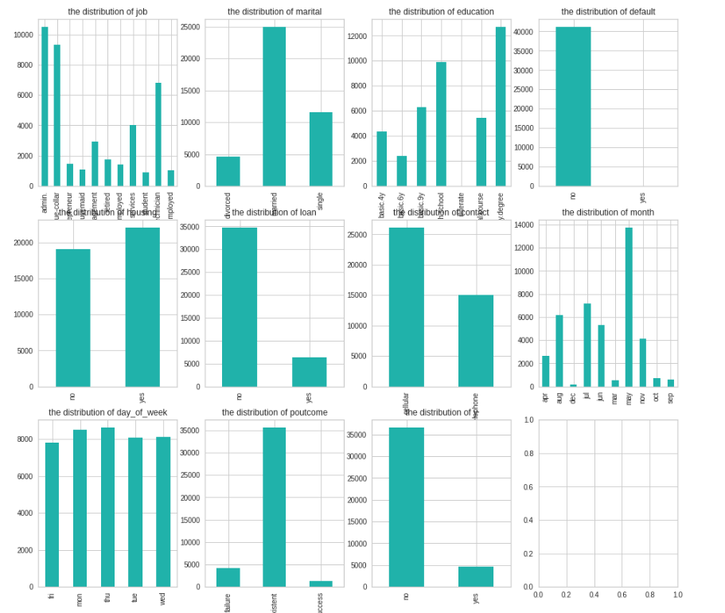
Data Preprocessing
Model Building
Model Enhancement
Economic Analysis
Data Overview - Categorical Variables
Notes:
For large-ranged continuous variables, we standardized them.

Slide 8
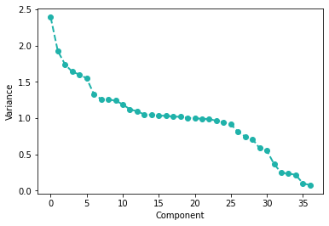
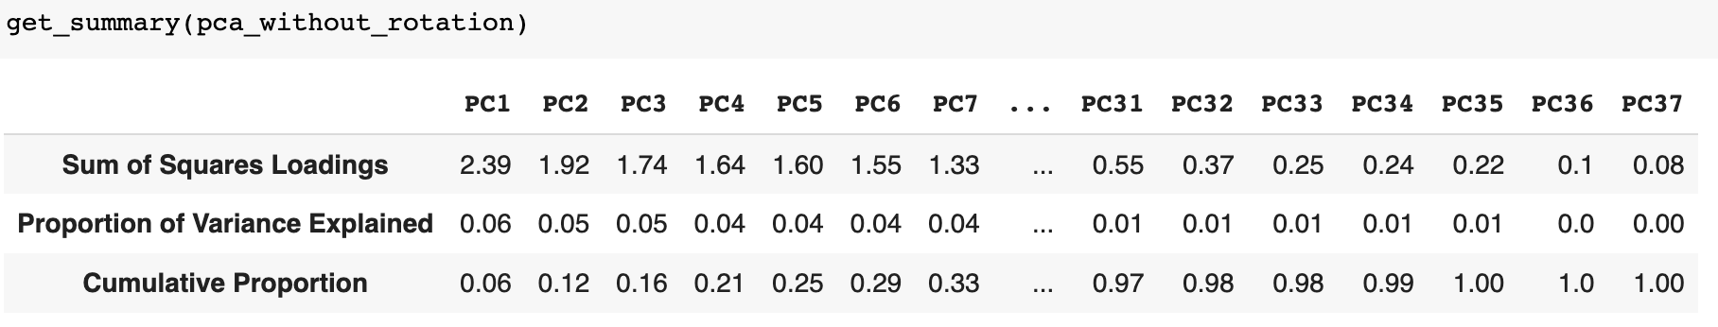
Data Preprocessing
PCA for Categorical Variable
Data Preprocessing
Model Building
Model Enhancement
Economic Analysis
We used only the first six principal components to reduce the dimension of dummies
Notes:
After one-hot encoding, we found that those 37 dummy variables have limited explanatory power. So we would like to reduce the number of dummy variables by PCA. From the elbow plot, we decide to use the first 6 pcs.
PC3 represents people who has past success experience: load heavily on psuccess

Slide 9
Models For Explaining And Prediction
Part 2

Slide 10
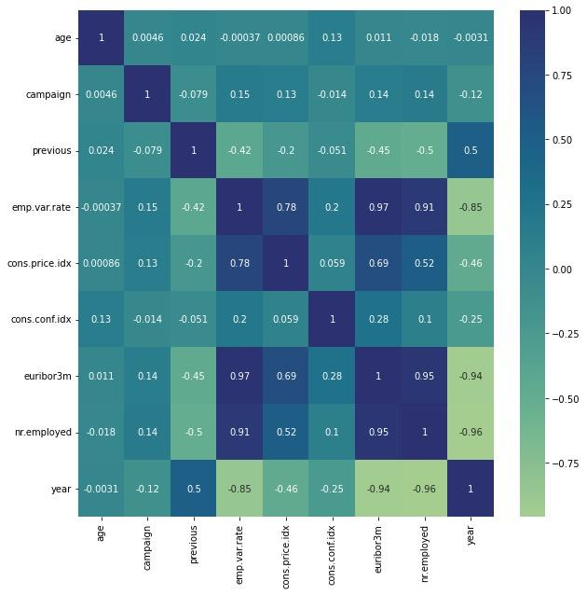
Data Preprocessing
Model Building
Model Enhancement
Economic Analysis
On Continuous Variables
After Scaling
Macroeconomic Indicators are highly correlated, therefore only use euribor3m, and dropped other Macroeconomic variables for logistic regression
Logistic Regression - Correlation Matrix
Notes:
Because we need to predict the probability of subscription, we first choose to build a logistic regression. Before doing so, we plot a correlation matrix and found that several macroeconomic indicators are highly correlated with each other. So we dropped 3 of these variables and only left two macroeconomic indicators in the model.

Slide 11
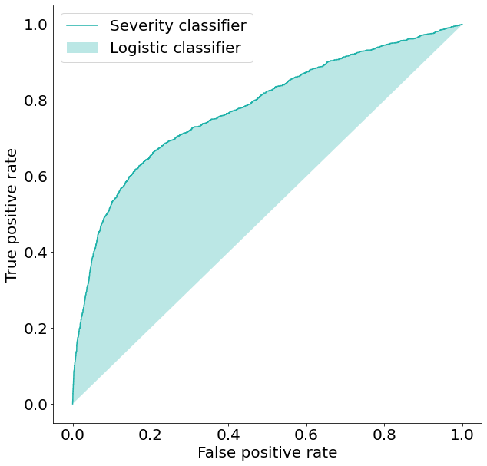
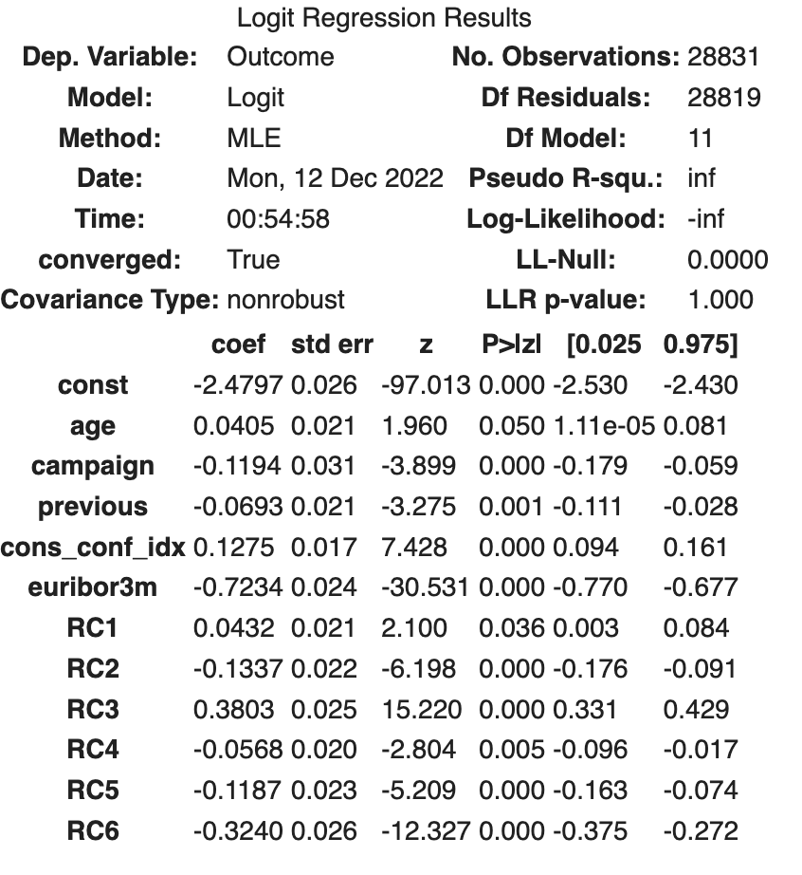
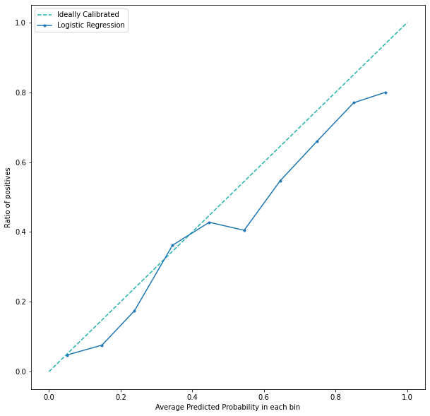
Logistic Regression - AUC
Data Preprocessing
Model Building
Model Enhancement
Economic Analysis
ROC Curve
AUC = 77.93%
Calibration Curve
Notes:
To see the accuracy of results, we plotted the ROC curve and calibration curve. The out-of-sample AUC is 78%, which is not too bad. So as the calibration curve. But it looks like the model is overestimating probabilities. what we found interesting is that a significant negative coefficient of 3 months euro interbank rate, or euribor3m here.

Slide 12
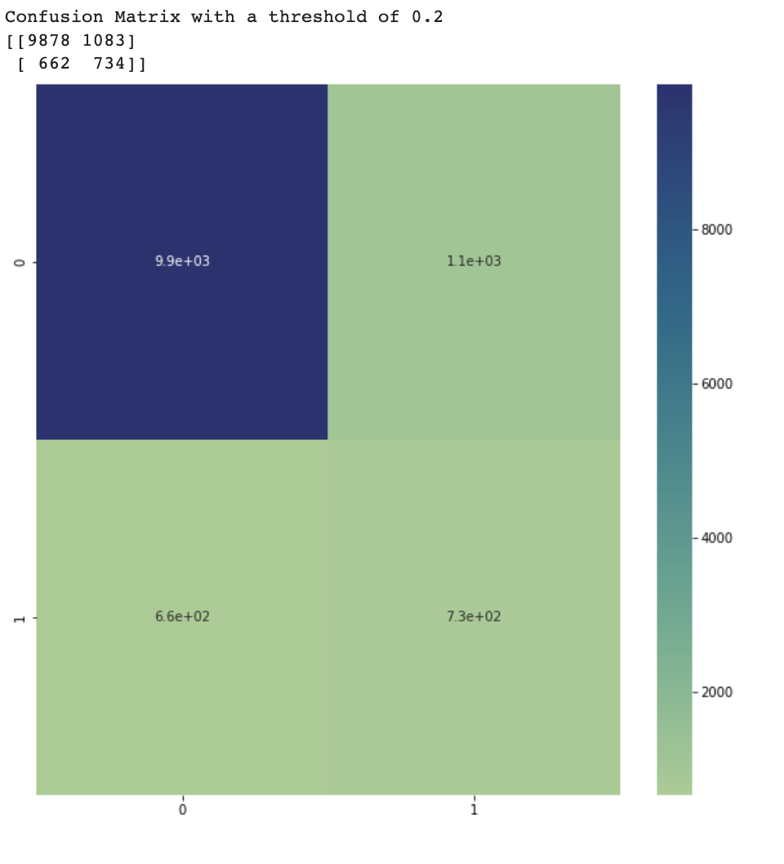
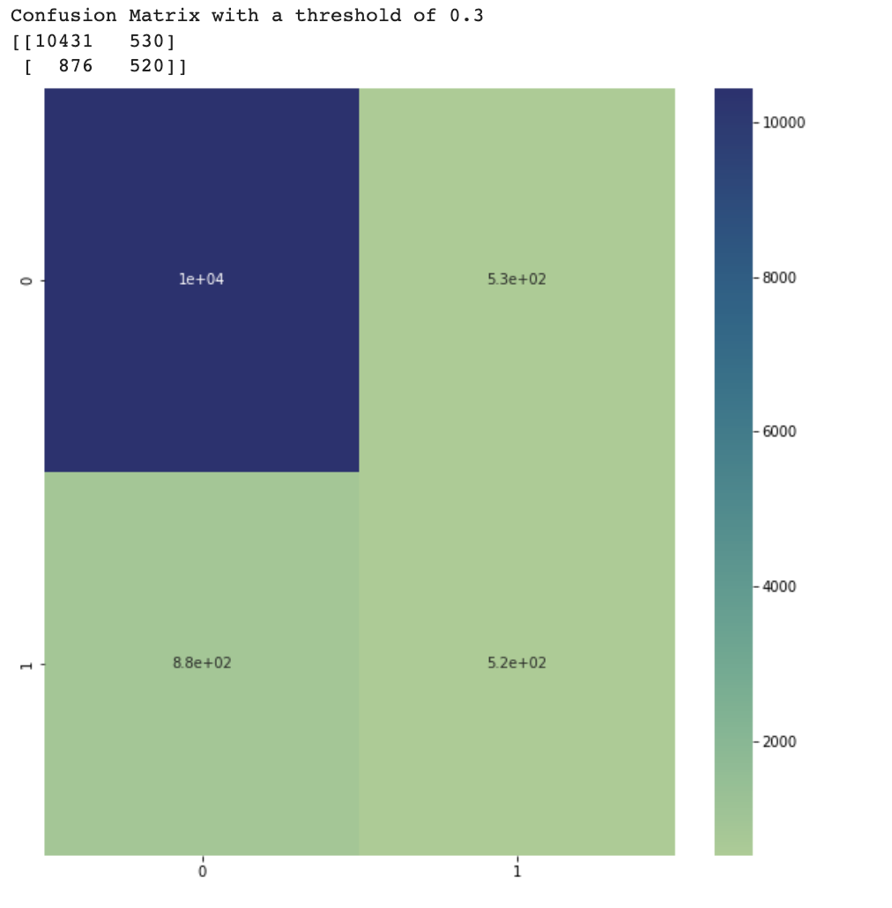
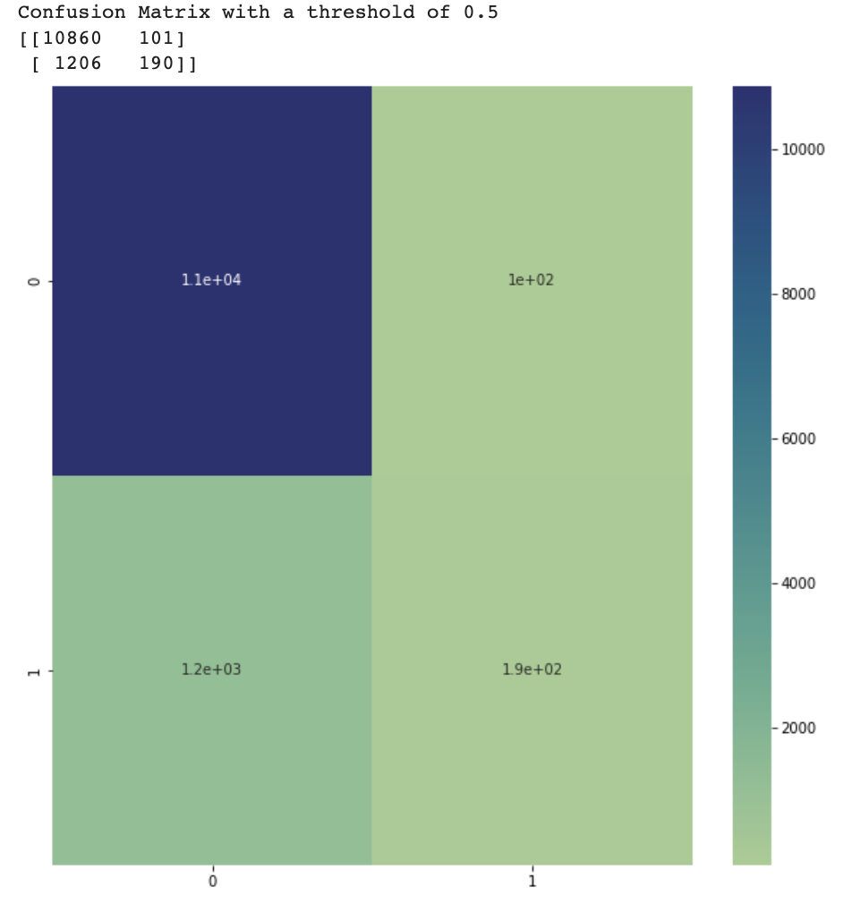
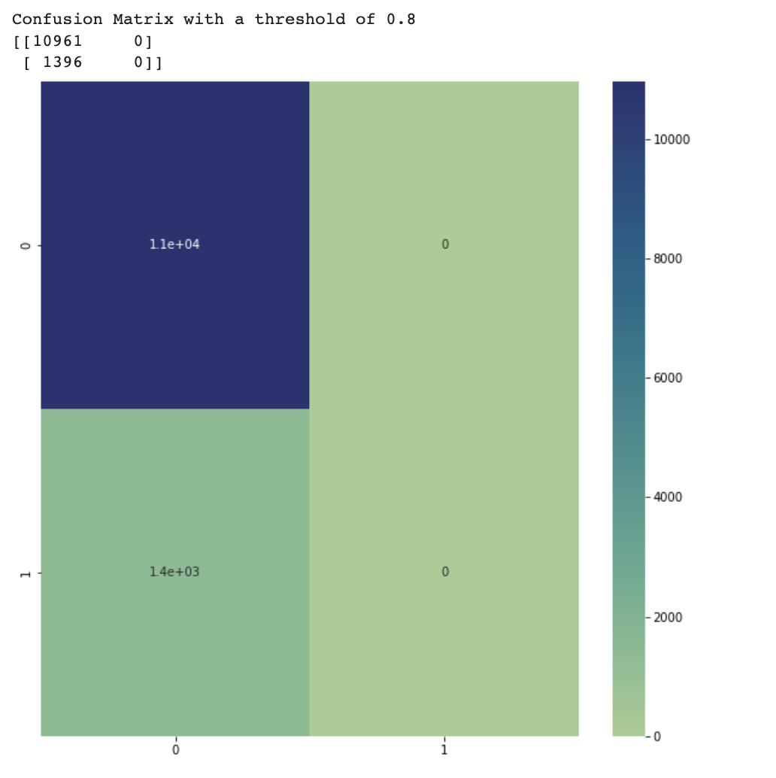
Logistic Regression - Confusion Matrix
Data Preprocessing
Model Building
Model Enhancement
Economic Analysis
Thresholds
0.2
0.3
0.5
0.8
Notes:
By changing thresholds of confusion matrices, we observe that while threshold increases, true positives decrease dramatically, and there are always many true negatives and false negatives.

Slide 13
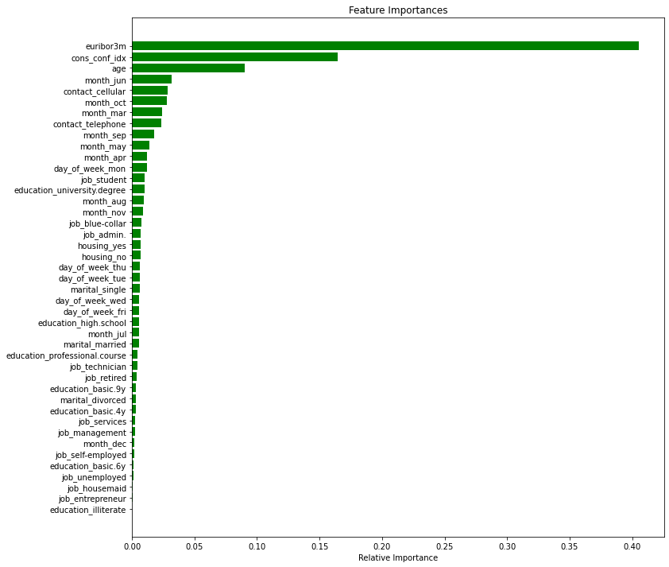
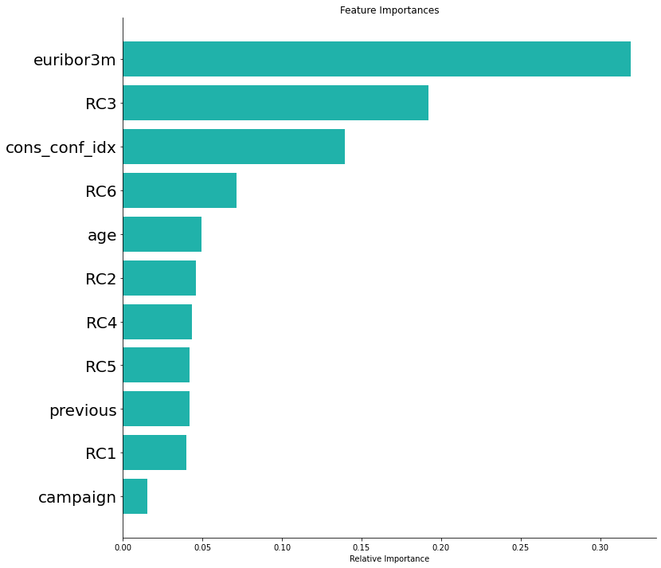
Random Forest – Feature Importances
Data Preprocessing
Model Building
Model Enhancement
Economical Analysis
AUC Before PCA: 0.8876
AUC After PCA: 0.8920
Notes:
We would also like to answer the question of which factors affect the success of a campaign, so we build a random forest model. We ran a random forest before and after PCA, and found that Euribor3m, consumer confidence index, age, and RC3, which is an indicator of whether this customer has bought the product before, are most important.

Slide 14
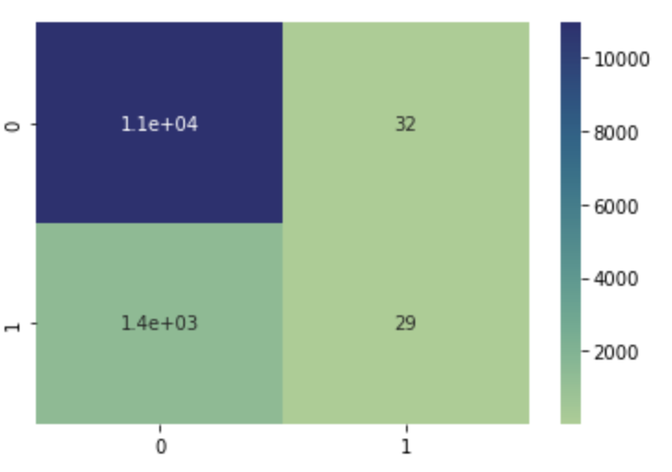
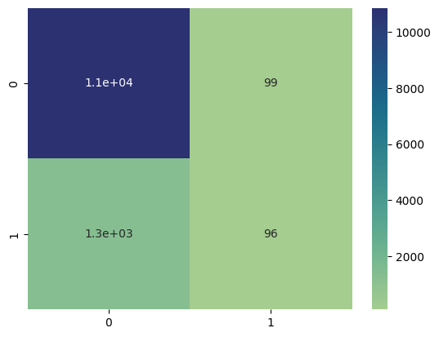
Random Forest – Bootstrapping
Data Preprocessing
Model Building
Model Enhancement
Economic Analysis
Accuracy Before PCA: 0.8868
Accuracy After PCA: 0.8868
Notes:
From the confusion matrices of random forest we conclude the same as the logistic model, that there are way more false negatives and true negatives. We therefore suspect the high accuracy is cause by unbalanced data.

Slide 15
Model Enhancement
Part 3

Slide 16
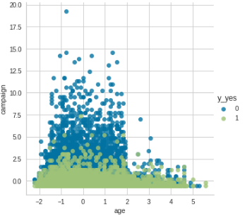
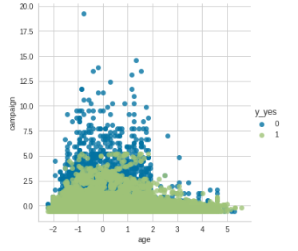
Unbalanced Data Problem
Data Preprocessing
Model Building
Model Enhancement
Economic Analysis
36548 labeled ‘No’ vs. 4640 labeled ‘Yes’
Balanced!
SMOTE-NC
25587 labeled ‘No’
25587 labeled ‘Yes’
Oversampling
Have continuous and categorical variables
Before
After
Notes:
To deal with imbalanced data, we choose Smote-NC for oversampling. (Next Next)
so now the labels for training data are balanced. (Next)
At the same time, the total training sample size increased.

Slide 17
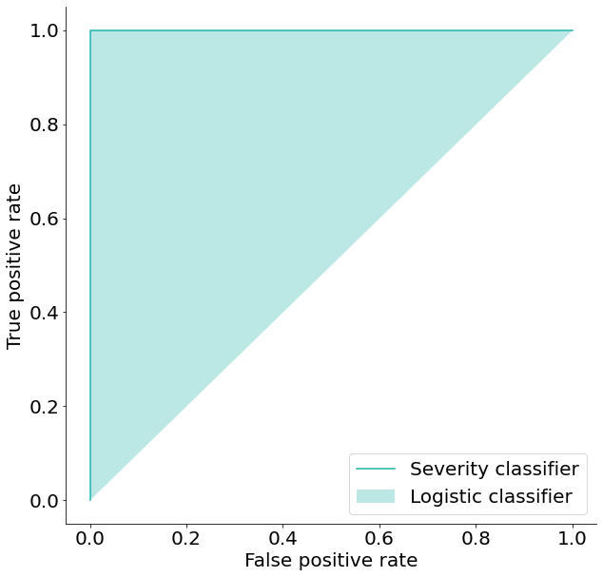
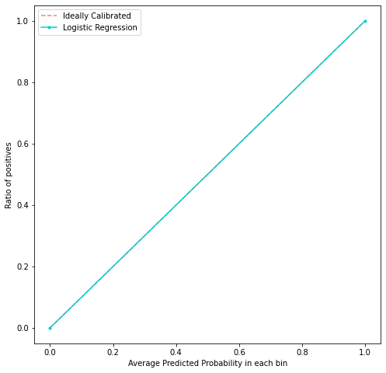
Logistic Regression After SMOTE-NC
Data Preprocessing
Model Building
Model Enhancement
Economic Analysis
Claim: The data is linearly separable by a hyperplane.
Notes:
We run the regression model again and found a really surprising result of out-of-sample AUC equals 1.
We doubled check the performance of the model in predicting probabilities by a calibration curve. The perfect overlapping of the curves shows we have done so well to fit the reality.
We suspect this result is caused by some intrinsic reason with the Data itself, like it’s already linear separable by a hyperplane.

Slide 18
Validate: SVM After SMOTE-NC
Data Preprocessing
Model Building
Model Enhancement
Economic Analysis
euribor3m!
Before SMOTE-NC
After SMOTE-NC
Notes:
To tested out our belief, we tried Support Vector Machine. By altering penalty level, we found that in most of the time SVC also gives an before and after SMOTE out-of-sample AUC of 1.
So, there indeed exists a hyperplane, or in other words, a certain dominating predictor could separate between "yes" and "no"'s.
From the previous evidence, we propose this predictor to be "Euribor3m"--the euro bank interest rate (Next)
If this is true, it would make prediction so much easier,because we need to only focus on public Macro Economical metric, which is already available.

Slide 19
Review of what we have done so far…
Data Preprocessing
Model Building
Model Enhancement
Economic Analysis
We have almost completed the task from Portugal Bank:
Predicting the likelihood of subscribing – Logistic Regression
What factors are mostly likely to increase a customer’s probability of subscribing
Euribor3m, cons_conf_idx, age, also the “RC’s”
Questions:
Why does euribor3m obtain a counterintuitive negative coefficient?
Can we optimize our marketing performance also through maximizing profit?
Notes:
So far, we have completed the Bank's first and second tasks given to us.
However,
given such importance of "Euribor", we still wonder its counterintuitive effect.
Also, can we optimize our marketing performance by considering profit?

Slide 20
Economic Analysis
Part 4

Slide 21
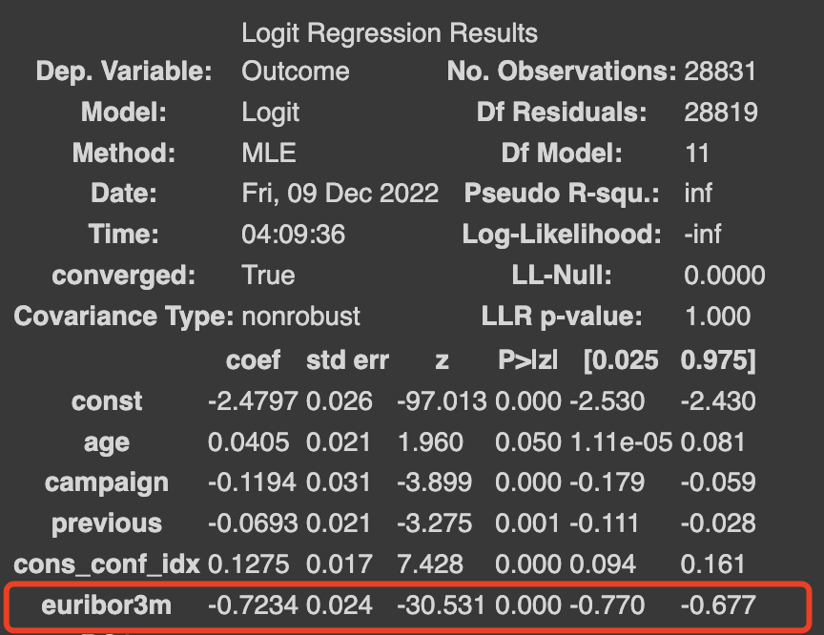
Interpretation: what does negative correlation between interest rates and subscription mean?
Data Preprocessing
Model Building
Model Enhancement
Economic Analysis
Basic Macroeconomic Relationship:
1
Long-term interest rate (Euribor 2Y/10Y)
V.S
short-term interest rate (Euribor 3M)
Interest rate up, save more
Our Model Finds:
WHY?
2
Government Policy:
Raise deposit Insurance cap
3
Low consumer confidence
resulted from crisis
-0.7234 shows increase in interest would lead to decrease in subscription, in other words, less savings are made
Notes:
For the first question, there are three reasons:
First, most people save money in the bank for more than a year, rather than only 3 months.
Second, many European governments set a policy to raise the deposit insurance cap, raising the compensations for savers.
Third, most customers were afraid that high interest rates would lead to another bubbling market. So they feel much safer with low interest rates.

Slide 22
Draft cost matrix for profit prediction and confusion matrix
Data Preprocessing
Model Building
Model Enhancement
Economic Analysis
Assumption:
A: Telemarketing Cost per Customer
B: Profit per Customer Subscription
m: to what extent would the telemarketing increase the subscription, in percentage
Cost Matrix Table
 | Treatment - 0 (not call) | Treatment - 1 (call)
Outcome - 0 (non-subscribe) | 0 | -A
Outcome - 1 (subscribe) | +B | -A + B*(1+m)
Notes:
For the second question, we consider selecting a best classifier to maximize the payoff. By making the assumptions a, b and m, we have the cost matrix like this. Also note that customers who being called have a bigger probability of subscribing, which need to multiply by (1+m)

Slide 23
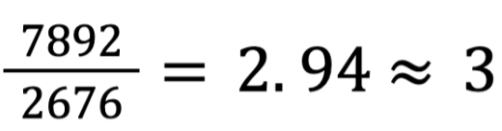
How to estimate the cost in Portugal 2008 - 2010?
Data Preprocessing
Model Building
Model Enhancement
Economic Analysis
2022 US telemarketing cost: 75 per hour
2022 US Labor cost 25 per hour
→ Scale it to Portugal Cost via Wage Difference vector:
2022 Portugal telemarketing cost: 75/3 = 25 per hour
2022 Portugal Labor cost 25/3 = 8 per hour
→ Scale to 2008 via Purchasing Power Parity:
2008 Portugal telemarketing cost: 25/1 = 25 per hour
2008 Portugal Labor cost 25/1 = 8 per hour
Telemarketing Cost (A)
Labor Cost
+
Cost per minute call * Average Duration of the calls
Notes:
So for estimating the unit cost A, we first divide the cost into labor cost and phone cost,

Slide 24
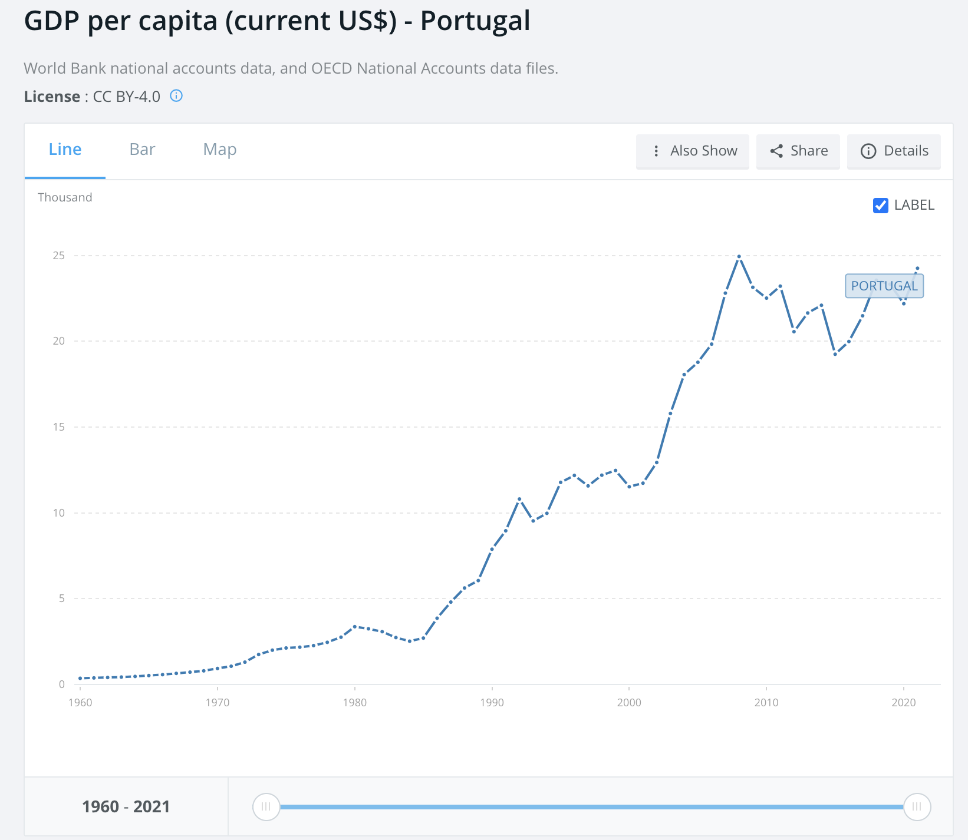
How to estimate the cost in Portugal 2008 - 2010?
Data Preprocessing
Model Building
Model Enhancement
Economic Analysis
Telemarketing Cost (A)
2022 US telemarketing cost: 75 per hour
2022 US Labor cost 25 per hour
→ Scale it to Portugal Cost via Wage Difference vector:
2022 Portugal telemarketing cost: 75/3 = 25 per hour
2022 Portugal Labor cost 25/3 = 8 per hour
→ Scale to 2008 via GDP per capita = 1:
2008 Portugal telemarketing cost: 25/1 = 25 per hour
2008 Portugal Labor cost 8/1 = 8 per hour
Labor Cost
+
Cost per minute call * Average Duration of the calls
Overall Telemarketing Cost
= 8 + 25*Average Duration
= 9.79
Notes:
We can use the labor cost of US in 2022 and scale it to Portugal in 2008 using wage difference and GDP per capita. So the unit cost A is about 10.

Slide 25
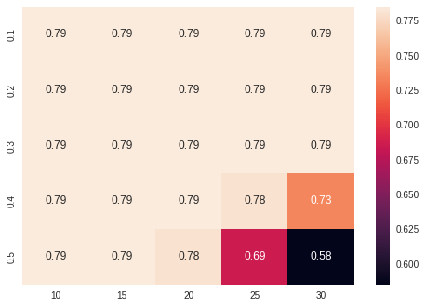
How to estimate the cost in Portugal 2008 - 2010?
Data Preprocessing
Model Building
Model Enhancement
Economic Analysis
Telemarketing Cost (A)
Overall Telemarketing Cost
= 8 + 25*Average Duration = 9.79
Labor Cost
+
Cost per minute call * Average Duration of the calls
Challenges & Experiments
Phase 1: A*(1, 1.5, 2, 2.5, 3) → no differences in classifier selection
Phase 2: try large numbers
Profit Per subscription (B)
Lack of References, Need to Estimate
→ A*(2.5, 5, 7.5, 10, 12.5)
Rate to increase subscription (m)
Sensitivity Analysis
to
test for a range from 0 to 0.5
Notes:
For B and m, we estimate by ourselves. For profit, we initially set profit to be small multiplier of cost, but it seems there’s no big difference. So we assume B to be 25 and m to be 0.2 for now.

Slide 26
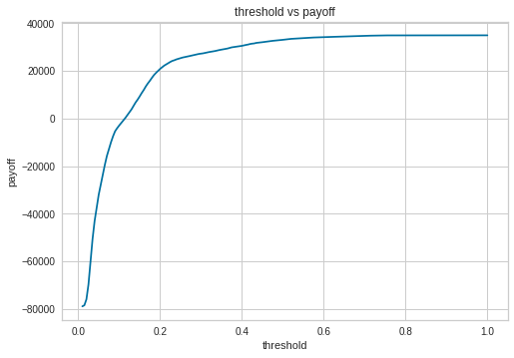
Method of finding the best classifier
Data Preprocessing
Model Building
Model Enhancement
Economic Analysis
Best payoff = 34,900
Given the best prediction model: logistic regression
Creating a continuous series [0,1] for threshold i:
Iterate through all values of [0,1] with step of 0.005
The payoff π given threshold i =
cost matrix * confusion matrix with threshold level i
Assume: cost matrix (A=10, m=0.2, B=25)
Confusion matrix (logistic regression, threshold=i)
Find the best classifier:
The largest π with the respectively threshold i
Best threshold = 0.79
Notes:
Then, we try to find the best classifier. The algorithm is mainly iterating the threshold I, and find the i that maximize the payoff which equals to the multiplication of cost matrix and confusion matrix. The best payoff is 35 thousand with threshold 0.79.

Slide 27
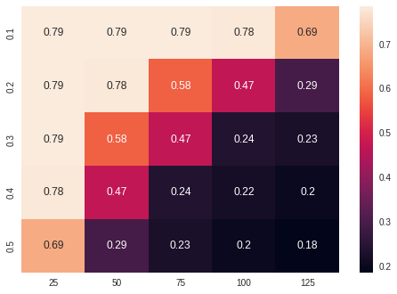
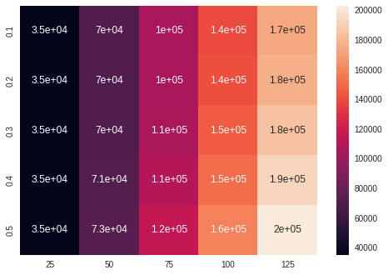
Sensitivity analysis: Trying various values of inputs
Data Preprocessing
Model Building
Model Enhancement
Economic Analysis
Best threshold values of the classifier
Best payoff values of the respective thresholds
m
Rate to increase subscription
m
Rate to increase subscription
B - Profit Per subscription
B - Profit Per subscription
Conclusions: Only when the unit profit is large enough (>=3 times the unit cost), can the bank profit from telemarketing and have a much larger preference to give subscriptions to customers (lower value of threshold that divides the result into 0 or 1).
Notes:
Finally, we conducted a sensitivity analysis by trying values of m and B to see how best threshold and payoff change. As unit cost is $10, the unit profit should at least exceed $50 so that the best threshold can be below 0.5. This means that only when the unit profit is large enough, can the bank profit from telemarketing.
(if we still have time to say a wrap up):
As a conclusion for today, we would like to highly agree with the current market trends that telemarketing is not a preferred perfect way to target at customers and make profitable returns. With only profit greater than 12 times of the cost, it is worth taking telemarketing strategies for business growth.

Slide 28
Citation
S. Moro, P. Cortez and P. Rita. A Data-Driven Approach to Predict the Success of Bank Telemarketing. Decision Support Systems, Elsevier, 62:22-31, June 2014
S. Moro, R. Laureano and P. Cortez. Using Data Mining for Bank Direct Marketing: An Application of the CRISP-DM Methodology. In P. Novais et al. (Eds.), Proceedings of the European Simulation and Modelling Conference - ESM'2011, pp. 117-121, Guimaraes, Portugal, October, 2011. EUROSIS.
“Deposit Insurance.” FDIC, European Central Bank, 9 Oct. 2016, https://www.fdic.gov/resources/deposit-insurance/.
Magellan Solutions. “How Much Is the Cost of Telemarketing?” Magellan Solutions, 15 Sept. 2021, https://www.magellan-solutions.com/blog/cost-of-telemarketing/.
Murphy, Eliza. “Bank of America Accelerates US Minimum Hourly Wage to $22 as next Step to $25 by 2025.” Bank of America Accelerates US Minimum Hourly Wage to $22 as Next Step to $25 by 2025, Bank of America, 23 May 2022, https://newsroom.bankofamerica.com/content/newsroom/press-releases/2022/05/bank-of-america-accelerates-us-minimum-hourly-wage-to--22-as-nex.html.

Slide 29
Thank you!

Slide 30
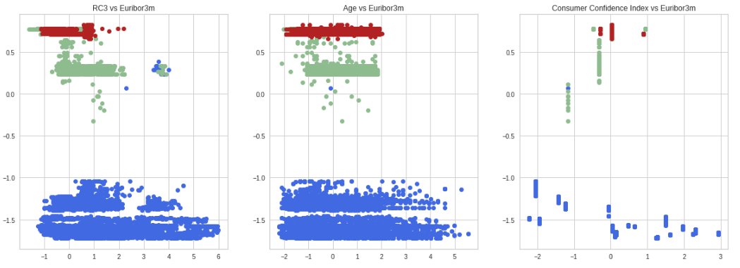
Linear Separability
Data Preprocessing
Model Building
Model Enhancement
Economic Analysis
Cluster Plots Involve Euribor

Slide 31
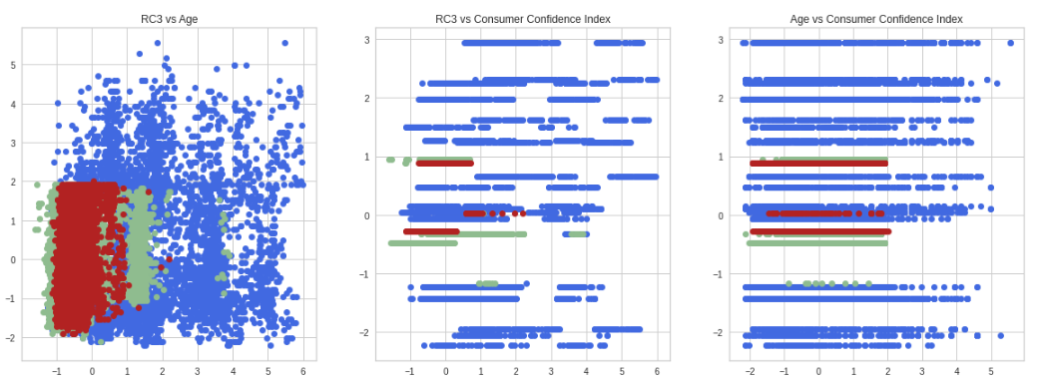
Linear Separability
Data Preprocessing
Model Building
Model Enhancement
Economic Analysis
Cluster Plots Not Involve euribor3m

Slide 32
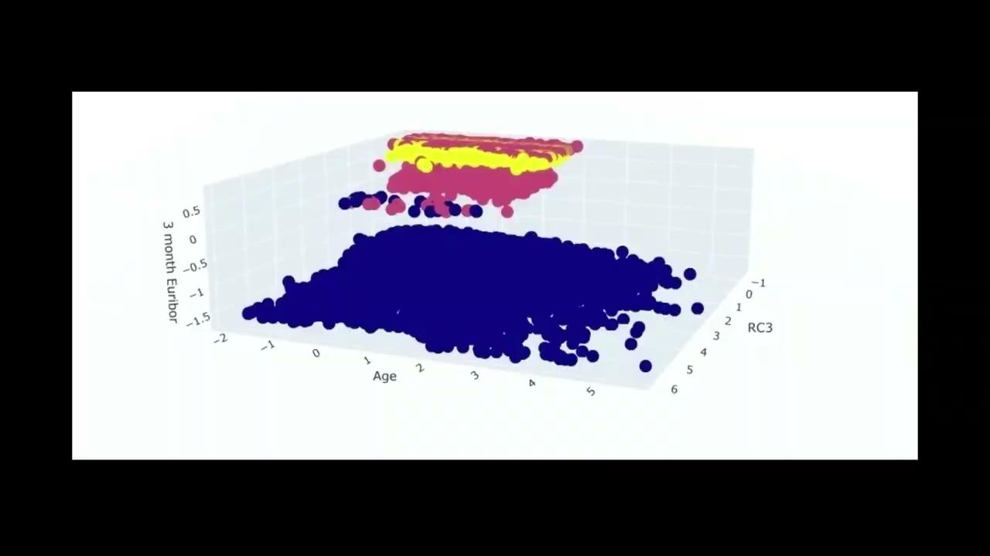
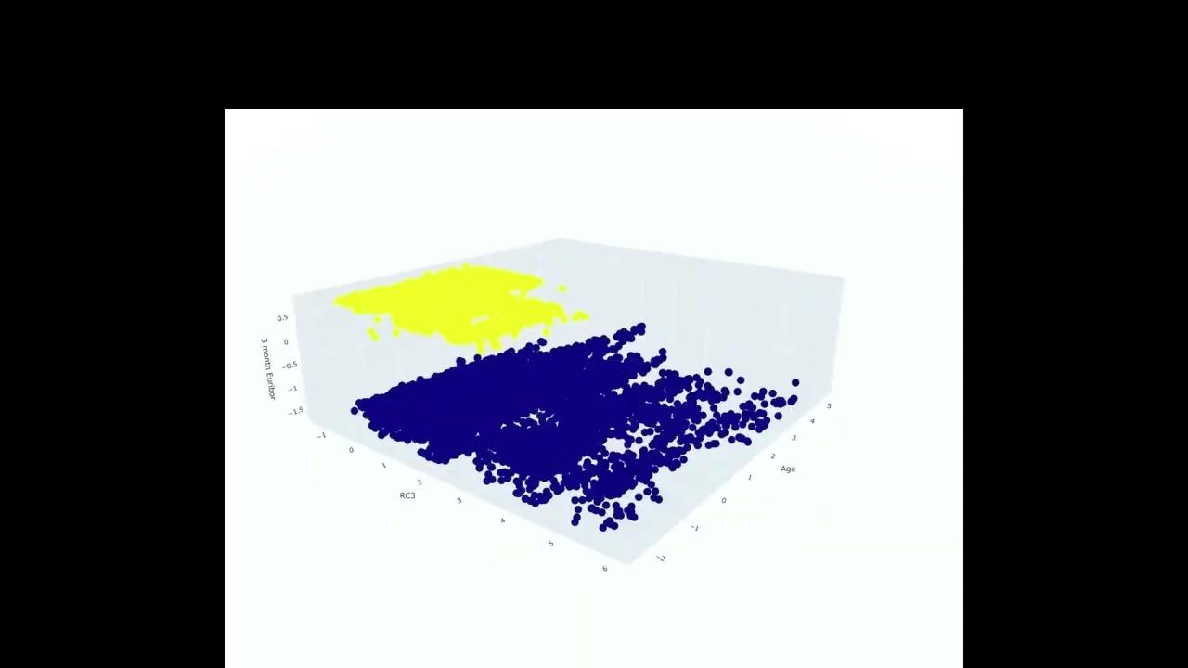
Linear Separability
Data Preprocessing
Model Building
Model Enhancement
Economic Analysis

